Slide 1
USER EXPERIENCE Paperless EOB
Research Study Results &
Recommendations
Jane Gallagher
2024

Slide 2
Agenda
Research Objective
Research Goals
Findings
Recommendations
Q&A

Slide 3
Research Objective
To obtain Users feedback, UX surveyed users to collect users’ feedback, challenges and pain points during the registration process starting from the ”Create an account” screen, and then the Enrollment summary page, MDB dashboard to understand what the user pain-points are that prevent them from “opting in” to Paperless EOBs.
Notes:
Make intro more brief = …"validate whats true". Or "Validating VoC comments"
Summary: Contact Us was findable on both Desktop and Mobile but Members still struggled to easily navigate to the page. A few simple changes to the labels and experience is recommended along with continued holistic research efforts with Providers and Employers audiences.
help us evolve our website an effort to
(Add here’s we’re at: Mention audiences/product – website strategy/process, and what we still need to do)
These are the business problems and how they connect to website
What's the impact: Why do we care
Do we want them to find contact info or not
Is there actually an issue? Understand the issue
Wide range Systemic problem, or nosiy few loud people (if contacting then)
Understand mental framework, and more places we surface and push people
Summary
Is it findable or not
How are the different audiences thinking about contact us &
Ramifications, and what we might think

Slide 4
Research Goals
Understand any challenges the user is facing when going to select or not select
opting into paperless EOBs
Assess :
If the users are or are not having issues locating the option to select Paperless EOBs on the Registration/ Create an Account page.
If the user has enough information and understands the options to select receiving paperless EOBs.
If the content is clear and if we are providing accurate information so the user understands what Paperless EOBs are.
If the users are opting in to Paperless EOBs, and if not, why.
Notes:
Make intro more brief = …"validate whats true". Or "Validating VoC comments"
Summary: Contact Us was findable on both Desktop and Mobile but Members still struggled to easily navigate to the page. A few simple changes to the labels and experience is recommended along with continued holistic research efforts with Providers and Employers audiences.
help us evolve our website an effort to
(Add here’s we’re at: Mention audiences/product – website strategy/process, and what we still need to do)
These are the business problems and how they connect to website
What's the impact: Why do we care
Do we want them to find contact info or not
Is there actually an issue? Understand the issue
Wide range Systemic problem, or nosiy few loud people (if contacting then)
Understand mental framework, and more places we surface and push people
Summary
Is it findable or not
How are the different audiences thinking about contact us &
Ramifications, and what we might think

Slide 5
Findings
User Testing

Slide 6
Registration Feedback – User Comments
"I really like the save, save some trees.”
“Provide the benefits to going paperless. Go green, save paper and get quick access to your account.”
“My own inclination is always paperless.”
“..to save paper and resource(s).”
Yes, I would um want a paperless explanation of benefits to already be selected because um this will show that I need to click on it so that I will have more urge to to subscribe to it…
“Storage, keep less paper to keep insects away or to have it mailed once so I can give it a read from the convenience of my armchair to see any important helpful information and then trash it (knowing) I can refer to the PDF version emailed to me.”
“I do this whenever I can. I vastly prefer paperless options to physical mail. It is easier to track and manage and store, and I believe it is safer and more reliable than physical mail.”

Slide 7
Paperless EOBs on Registration Tasks & Success Rate
Number of Responses
Selection of Paperless EOBs
When registering an account, did you select to have Paperless EOBs sent to you electronically?
Understanding options for receiving your Explanation of Benefits
Was it easy to understand the options for receiving your Explanation of Benefits (EOBs) by mail or electronically?
How easy was it to locate and select the options to receive your Paperless EOBs by mail or electronically?
Magic Wand
Effectiveness – Would you change anything?
Overall Experience
How would you rate your overall experience registering and selecting your Paperless EOB delivery preference?
Yes
No
88%
12%
17
88%
12%
17
100%
0%
17
Yes
No
0%
100%
17
Very Easy
Easy
88%
12%
17

Slide 8
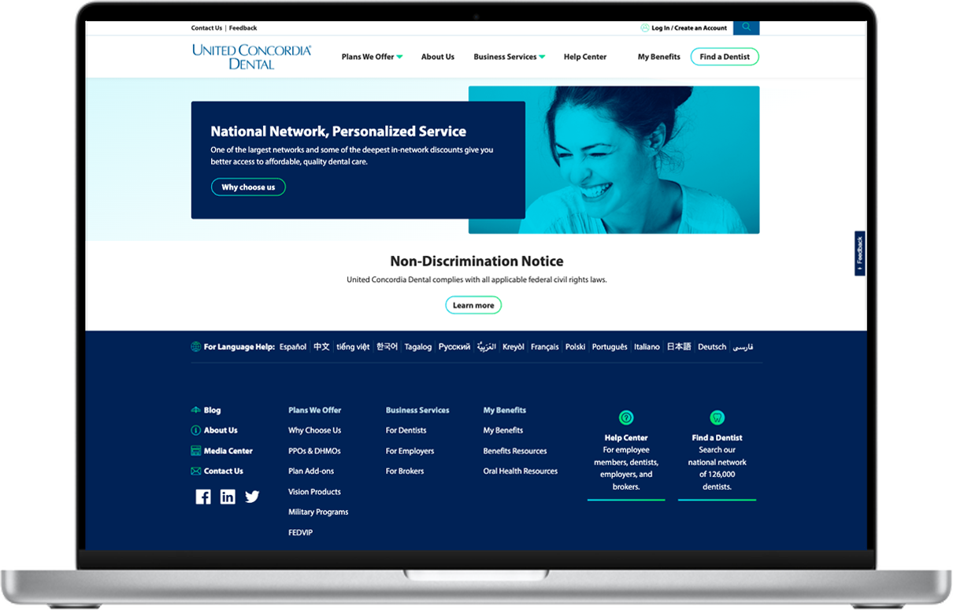
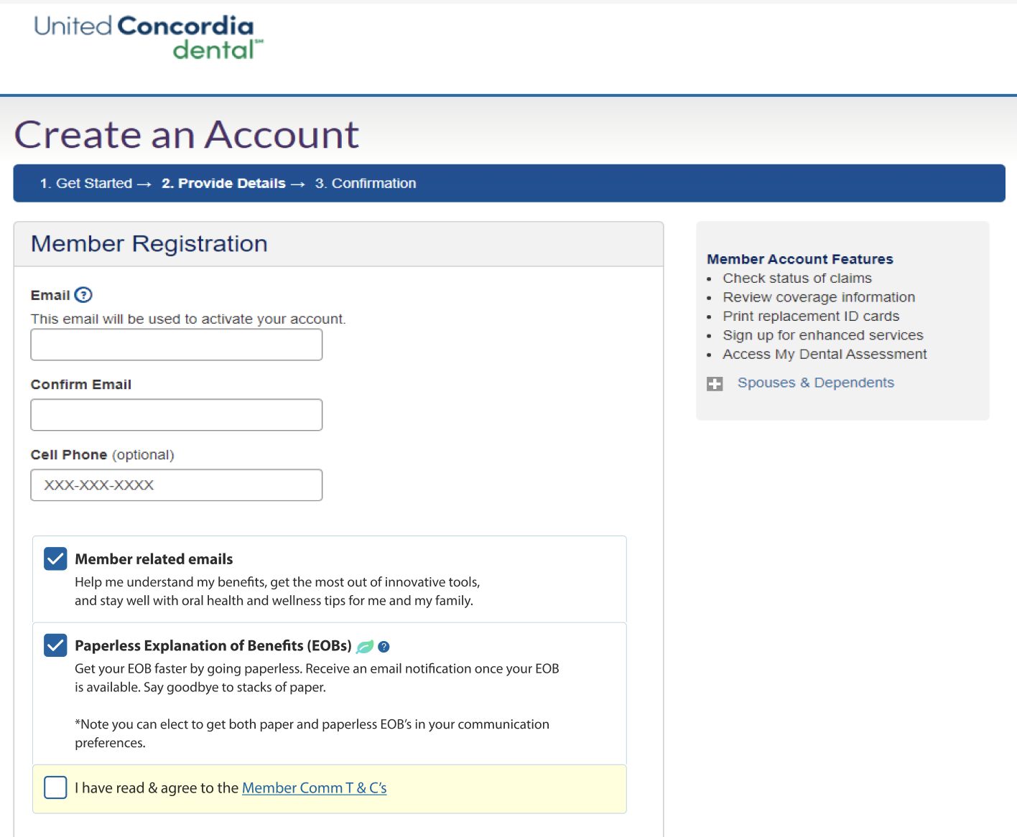
Create Account screen – current state
Finding Paperless EOB Information
Task Question: For the purposes of this study, assume that you already have purchased dental insurance, and you need to access your online account so you can update how you receive your dental statements. Please keep this in mind while completing this study.
Participants opted in on the Registration/Create Account page. 12% of participants voiced that there was not enough information about Paperless EOBs.
Out of 17 participants, 88% wanted Paperless to be preselected, 14% said that they preferred it to not be selected.
Users had to spend a considerable amount of time reading this page and trying to understand what action they were supposed to take. It was not immediately clear to them.
1
2
3
User Feedback:
"the box checked by default is much better."
Notes:
Task Question: For the purposes of this study, assume that you already have purchased dental insurance, and you need to access your online account so you can update how you receive your dental statements.
Please keep this in mind while completing this study.

Slide 9
AB Testing
Registration – Create an Account

Slide 10
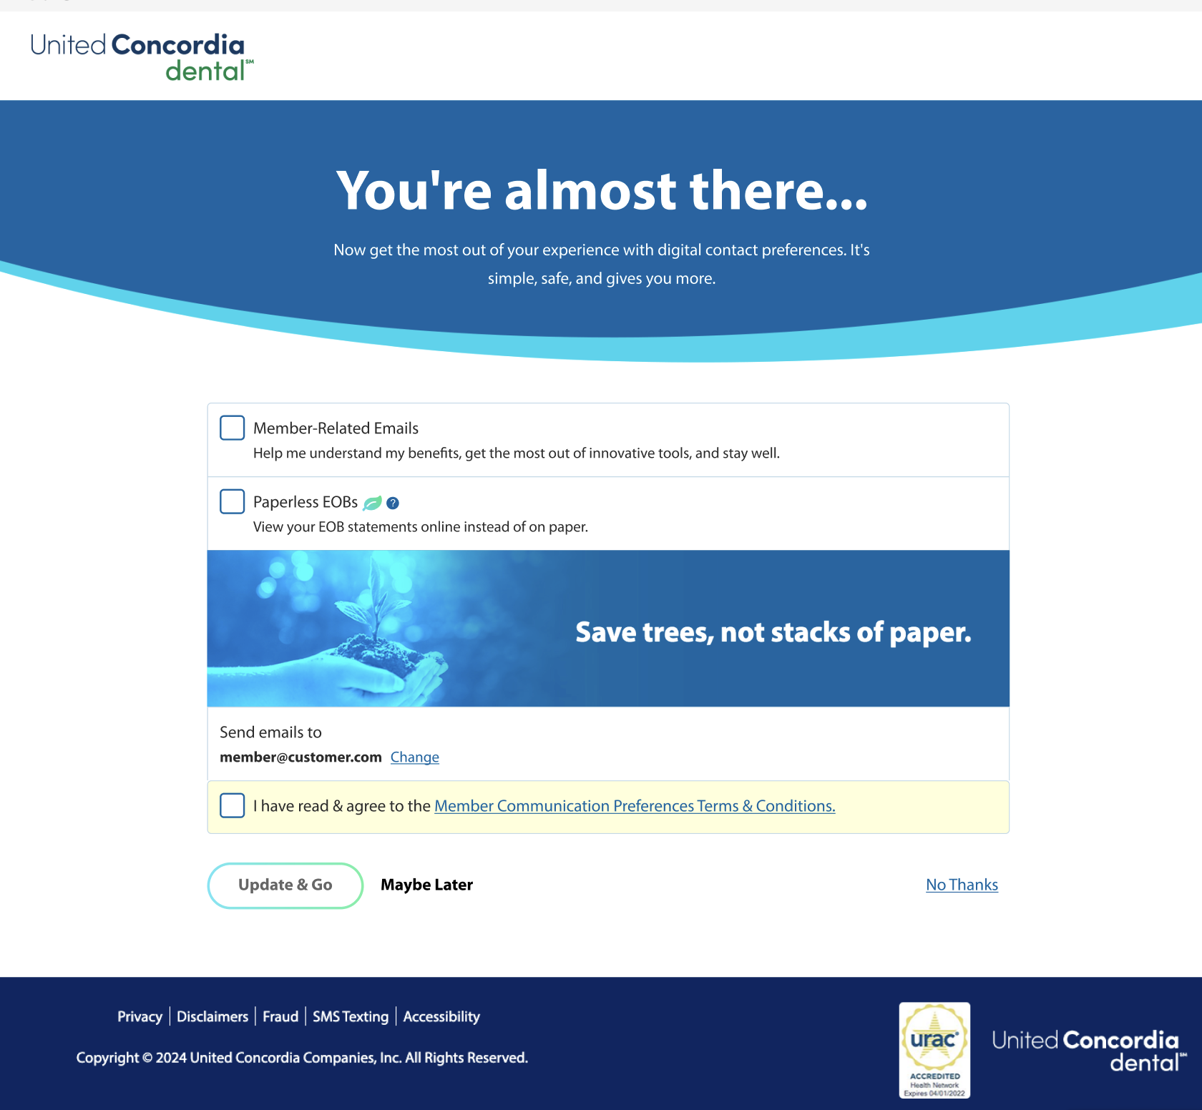
Relay Screen –
Finding Paperless EOB Information
Task Question: For the purposes of this study, assume that you already have purchased dental insurance, and you need to access your online account so you can update how you receive your dental statements. Please keep this in mind while completing this study.
1
When Participants encountered the Relay screen, participants were confused, skimmed this page and moved forward to complete the task.
Users read allowed the “Save trees” messaging, but did not spend a considerable amount of time reading this page or trying to understand what action they were supposed to take here, it was not clear to them.
Notes:
Task Question: For the purposes of this study, assume that you already have purchased dental insurance, and you need to access your online account so you can update how you receive your dental statements.
Please keep this in mind while completing this study.

Slide 11
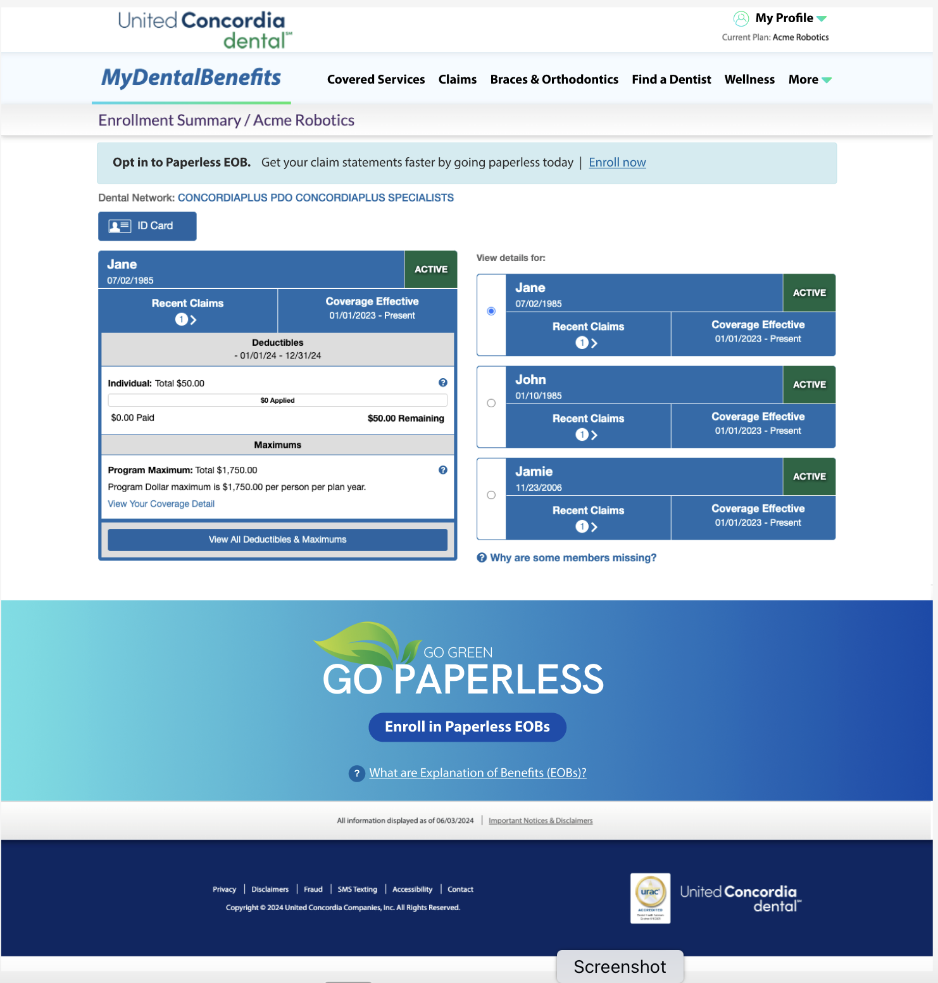
MDB Enrollment Summary – New Banner Alert
Finding Paperless EOB Information
Task Question: For the purposes of this study, assume that you already have purchased dental insurance, and you need to access your online account so you can update how you receive your dental statements. Please keep this in mind while completing this study.
Top Banner alert on MDB Enrollment Summary –
Task: Users were asked how would they update how they receive their dental benefit statement.
After overlooking the Relay page and moving forward to complete their task of updating how they will receive their dental statements; Participants landed on the My Dental Benefits enrollment Summary page and quickly used the new top banner alert. They made comments that they were hoping to find more information and asked for more information about Paperless EOBs on the Enrollment Summary screen.
1
Notes:
Task 1: Navigation - Task Setting & Validation
For the purposes of this study, assume that you already have purchased dental insurance and you need to access your online account so you can update how you receive your dental statements.
Please keep this in mind while completing this study.
They bi-passed the Relay page and used the banner Alert when they failed to find what they were looking for

Slide 12
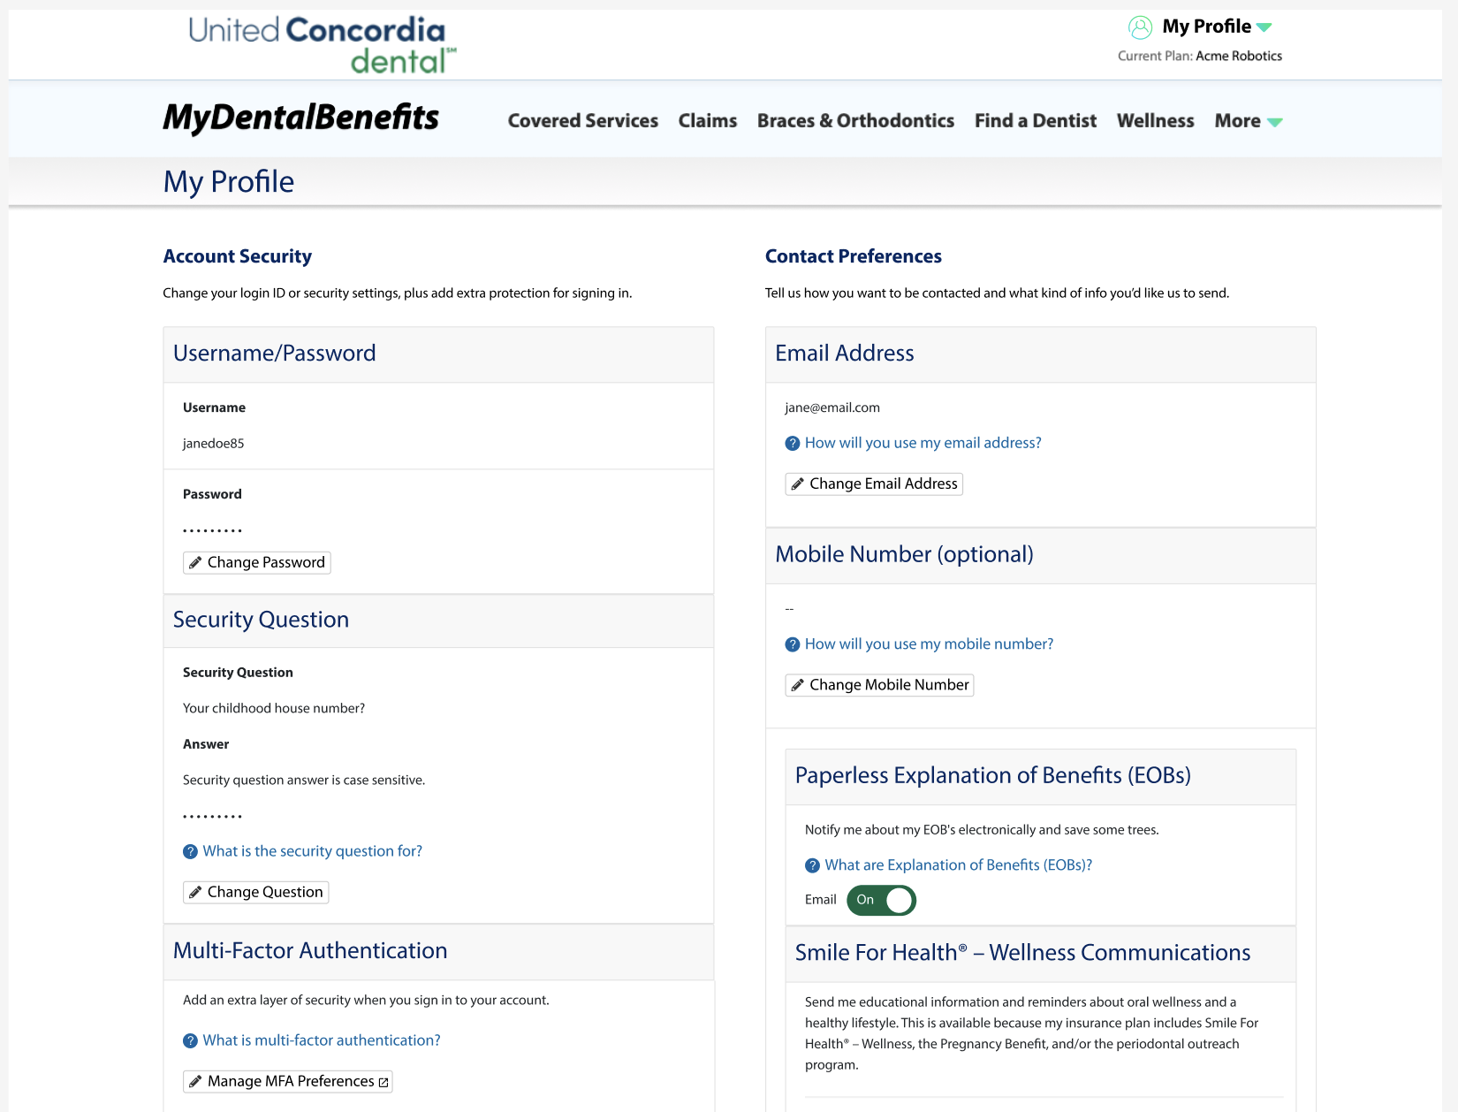
My Profile Page
Task Question: For the purposes of this study, assume that you already have purchased dental insurance, and you need to access your online account so you can update how you receive your dental statements. Please keep this in mind while completing this study.
MDB My Profile screen–
Task: Users were asked how would they update how they receive their dental benefit statement.
After choosing from the My Profile Menu; Participants landed on the My Profile screen, and opted into Paperless EOBs

Slide 13
Opportunities
Based on User research feedback

Slide 14
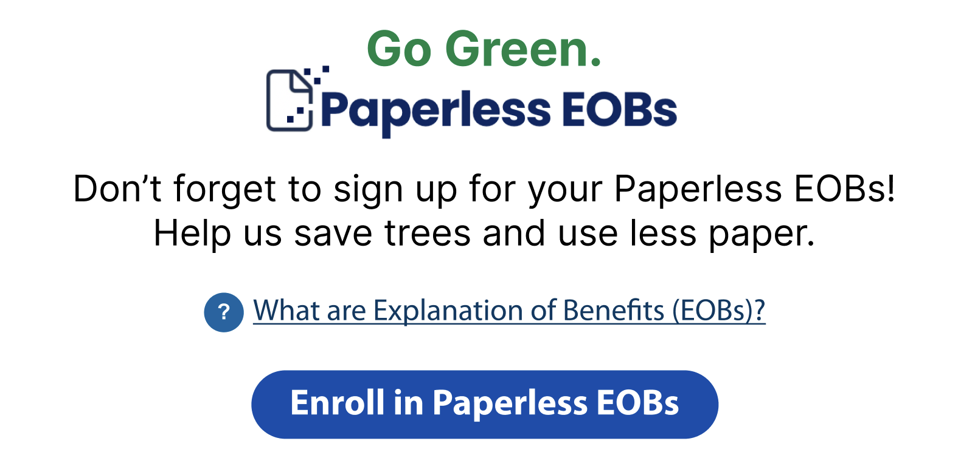
Address User Pain points through messaging for user’s who overlook paperless
Example 1 - Simple graphic messaging banner with messaging to go paperless.
Add Banners and ads throughout the user's journey as reminders to go Paperless.
1
Consider displaying Graphic banners and adds that make Paperless a key feature with messaging about why users should go paperless.
Provides a link to enroll in Paperless EOBs
Provides a link to What Paperless EOBs are
3
2
Create a brand with messaging that can be voiced to the user throughout the user's journey, building Paperless EOBs into a persistent feature. Market Paperless EOBs to users.
Notes:
Add
Add information about how to update PDO (Primary Dentist Office) or family information to help center and in MDB or linking MDB to Help Center
Help Center should be nurtured over time. Pruning what isn’t being used and adding new topics that align with VoC data
Help Center
We recommend maintaining (adding and removing) the Help Center and use consistent keywords in titles
Consider advocating for LucidWorks to improve the search functionality
ID
We recommend further research on the topic

Slide 15


Address User Pain points through messaging for user’s who overlook paperless
Example 2 - Bold graphic with messaging banner with messaging to go paperless.
Add Banners and ads throughout the user's journey as reminders to go Paperless.
1
2
Consider displaying Graphic banners and adds that make Paperless a key feature with messaging about why users should go paperless.
Provides a link to enroll in Paperless EOBs
Provides a link to What Paperless EOBs are
3
Notes:
Add
Add information about how to update PDO (Primary Dentist Office) or family information to help center and in MDB or linking MDB to Help Center
Help Center should be nurtured over time. Pruning what isn’t being used and adding new topics that align with VoC data
Help Center
We recommend maintaining (adding and removing) the Help Center and use consistent keywords in titles
Consider advocating for LucidWorks to improve the search functionality
ID
We recommend further research on the topic

Slide 16
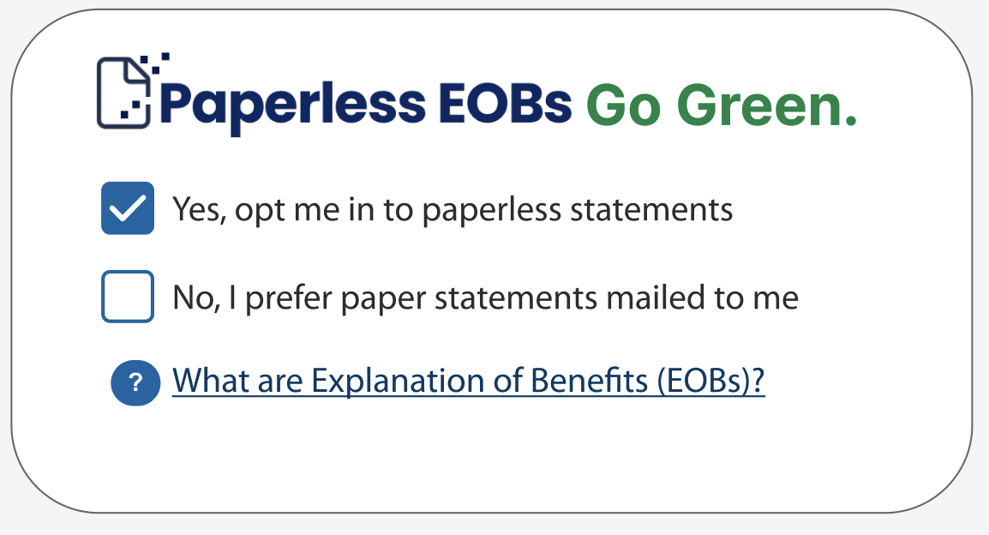
Registration Enhancements
Consider updating the Registration screen – simplify it.
Consider creating a graphic “Spotlight “ for Paperless EOB’s, simplifying the choices to Yes or No, with the pre-selected radio button set to Yes.
Pre-select the option to send paperless statements.
Add a tooltip link so the user can easily access and learn what EOBs are.
1
2
3
88% of Participants responded that they would prefer to have “Yes” pre-selected on the Registration screen.

Slide 17
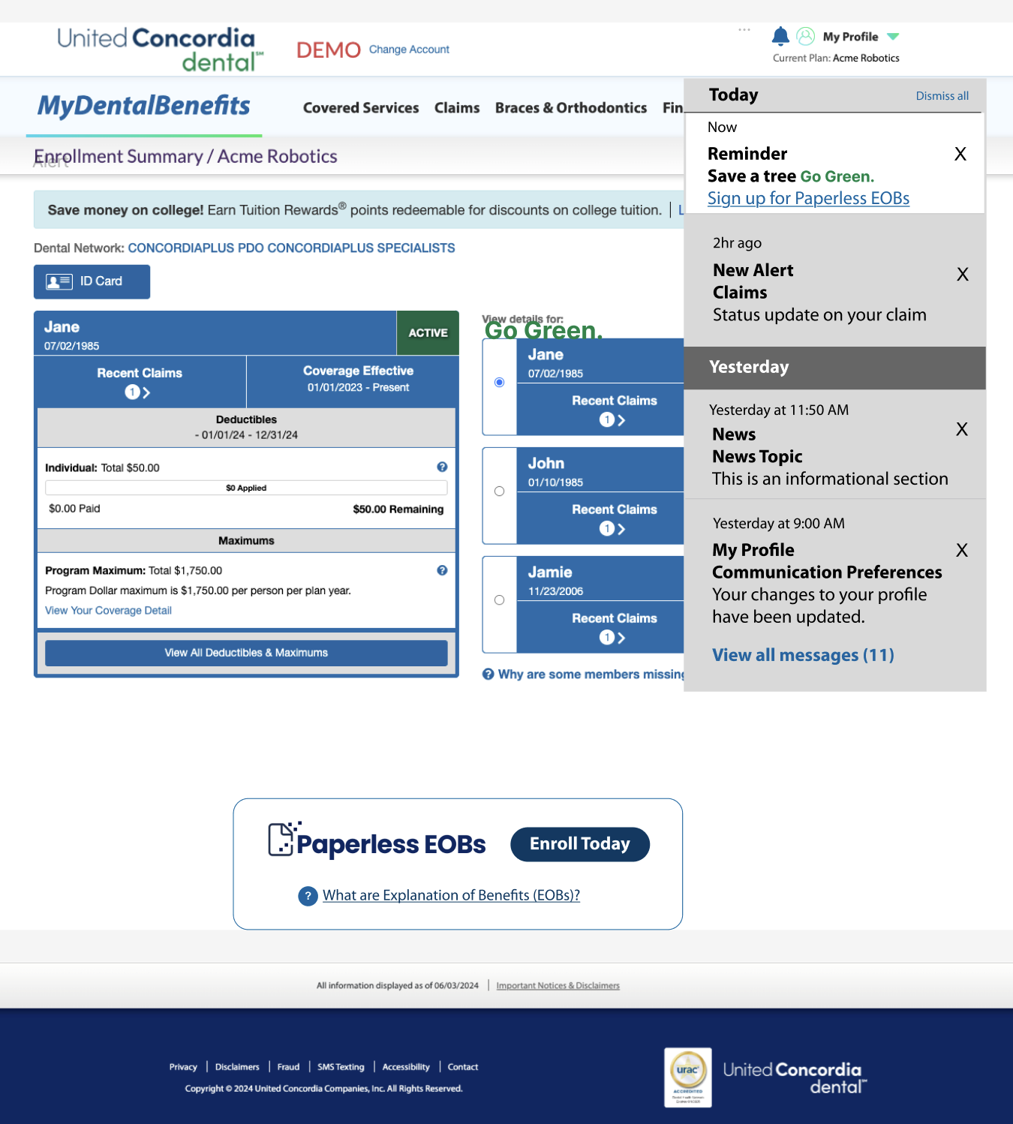
Notification
Enhancement
1
3
2
Consider enhancing the users experience with a notification center.
Add a notification “Bell” Icon
Add a Notification Panel
Provide hyperlink to go to relevant pages to take actions.
Include timestamps, ability for user to dismiss notifications, and ability for user to ”View all messages” in a Notification section.
4

Slide 18
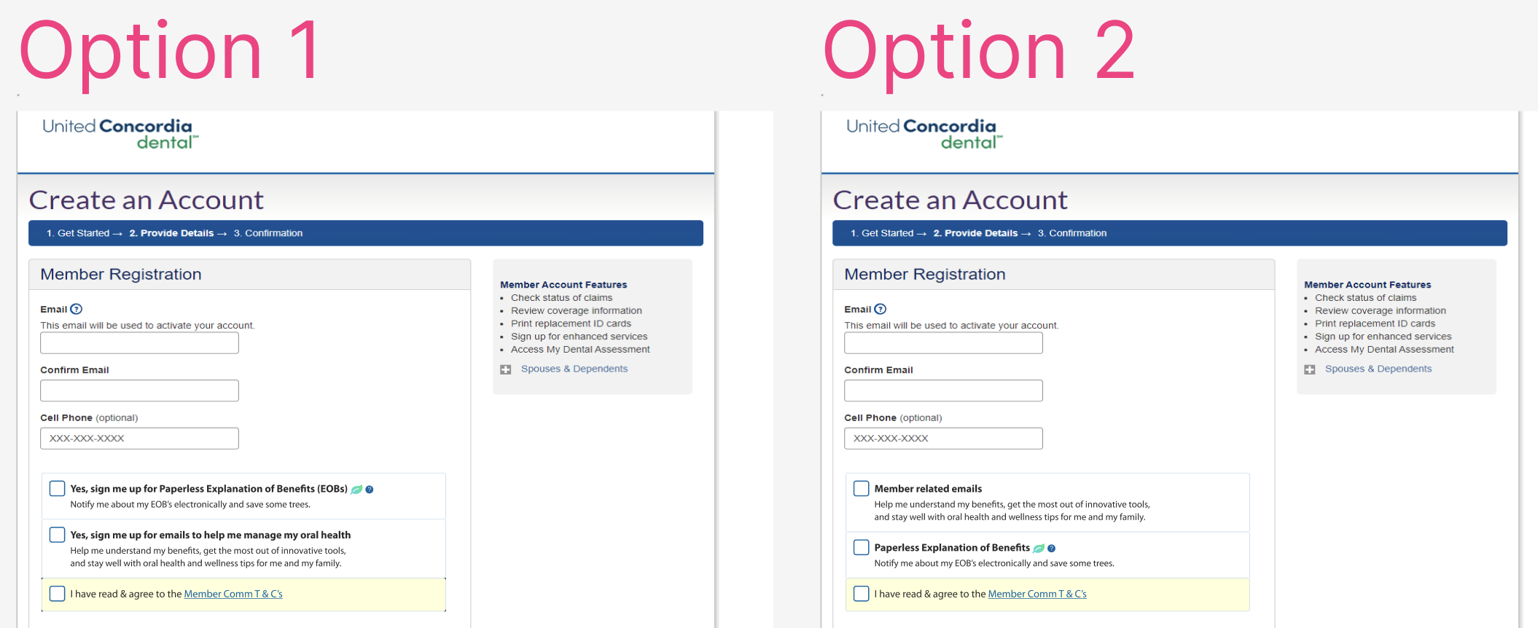
Registration Enhancement
A/B Test - Language
73%
73% of Participants Preferred simpler language that started with “Yes” for opting into Paperless EOBs.
4%
Notes:
Add
Add information about how to update PDO (Primary Dentist Office) or family information to help center and in MDB or linking MDB to Help Center
Help Center should be nurtured over time. Pruning what isn’t being used and adding new topics that align with VoC data
Help Center
We recommend maintaining (adding and removing) the Help Center and use consistent keywords in titles
Consider advocating for LucidWorks to improve the search functionality
ID
We recommend further research on the topic

Slide 19
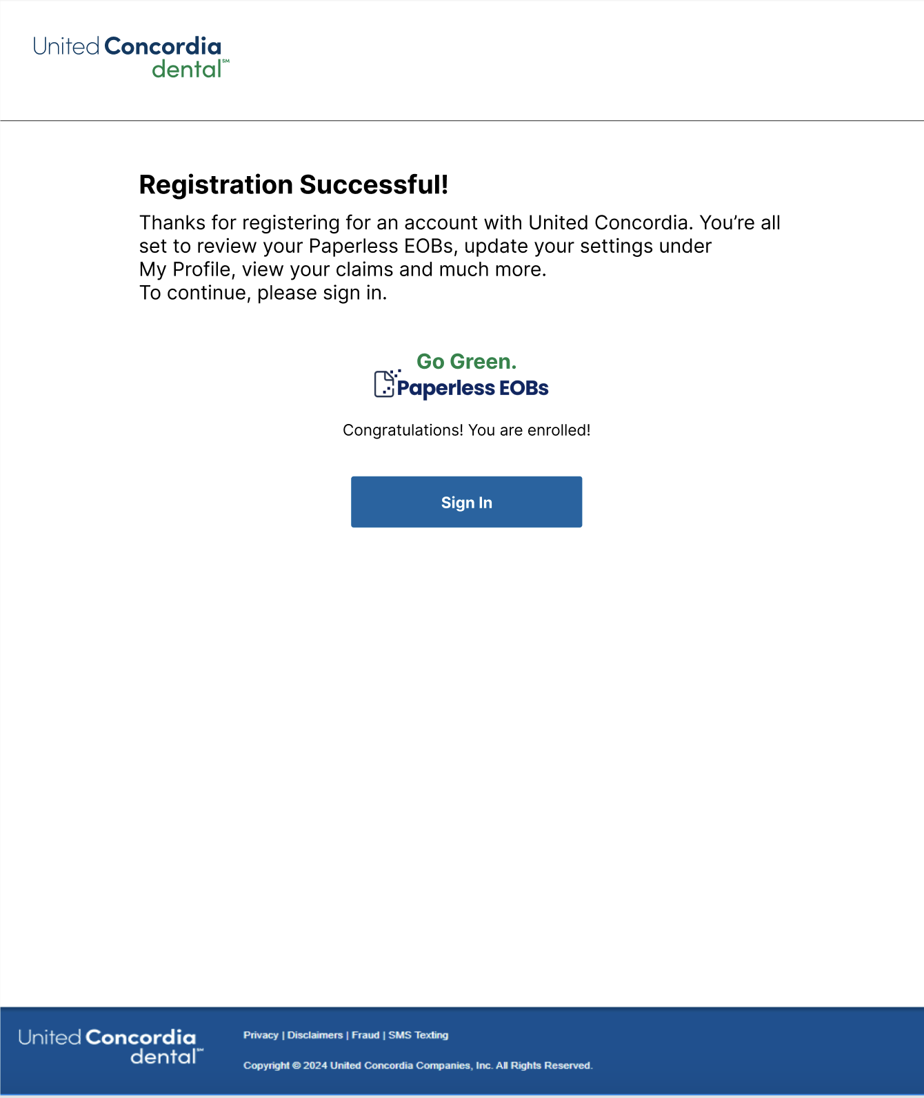
Pain-point: User does not recall opting in
Opportunity: Inform the user they have Registered and Have opted in to Paperless EOBs
Registration success screen, User opts in
1
2
3
Consider displaying a registration success screen letting the user know that their Registration was successful.
Consider displaying messaging that confirms that the user has opted in to Paperless EOBs, and then allows them to sign in.
Provide a link for the User to sign in to their account.
Notes:
Add
Add information about how to update PDO (Primary Dentist Office) or family information to help center and in MDB or linking MDB to Help Center
Help Center should be nurtured over time. Pruning what isn’t being used and adding new topics that align with VoC data
Help Center
We recommend maintaining (adding and removing) the Help Center and use consistent keywords in titles
Consider advocating for LucidWorks to improve the search functionality
ID
We recommend further research on the topic

Slide 20
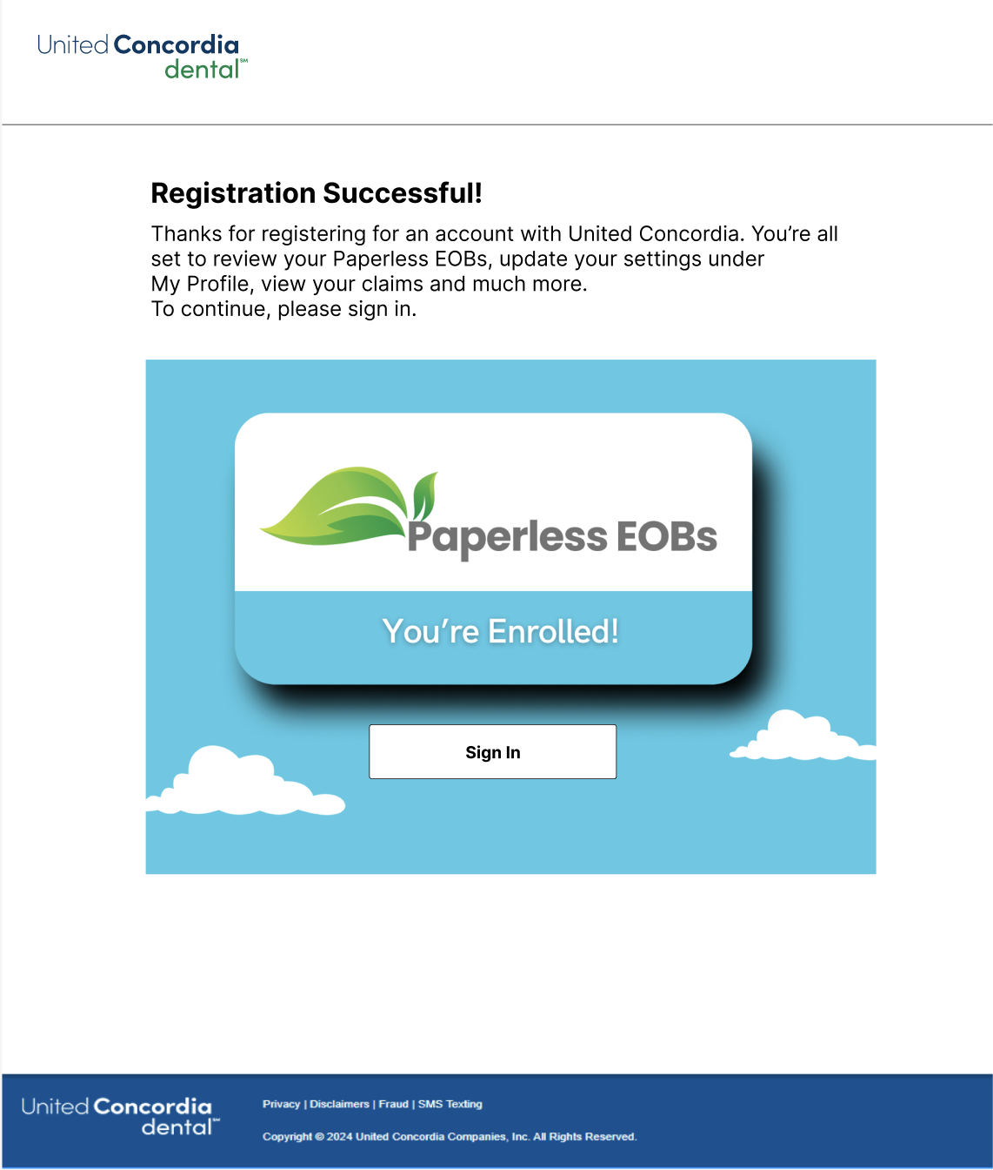
Graphic Style - Registration Success Enhancement -
Sign in screen, User opts in
1
Consider displaying a registration success screen letting the user know that their Registration was successful.
Consider displaying messaging that confirms that the user has opted in to Paperless EOBs, and then allows them to sign in.
Provide a link for the User to sign in to their account.
2
3
Notes:
Add
Add information about how to update PDO (Primary Dentist Office) or family information to help center and in MDB or linking MDB to Help Center
Help Center should be nurtured over time. Pruning what isn’t being used and adding new topics that align with VoC data
Help Center
We recommend maintaining (adding and removing) the Help Center and use consistent keywords in titles
Consider advocating for LucidWorks to improve the search functionality
ID
We recommend further research on the topic

Slide 21
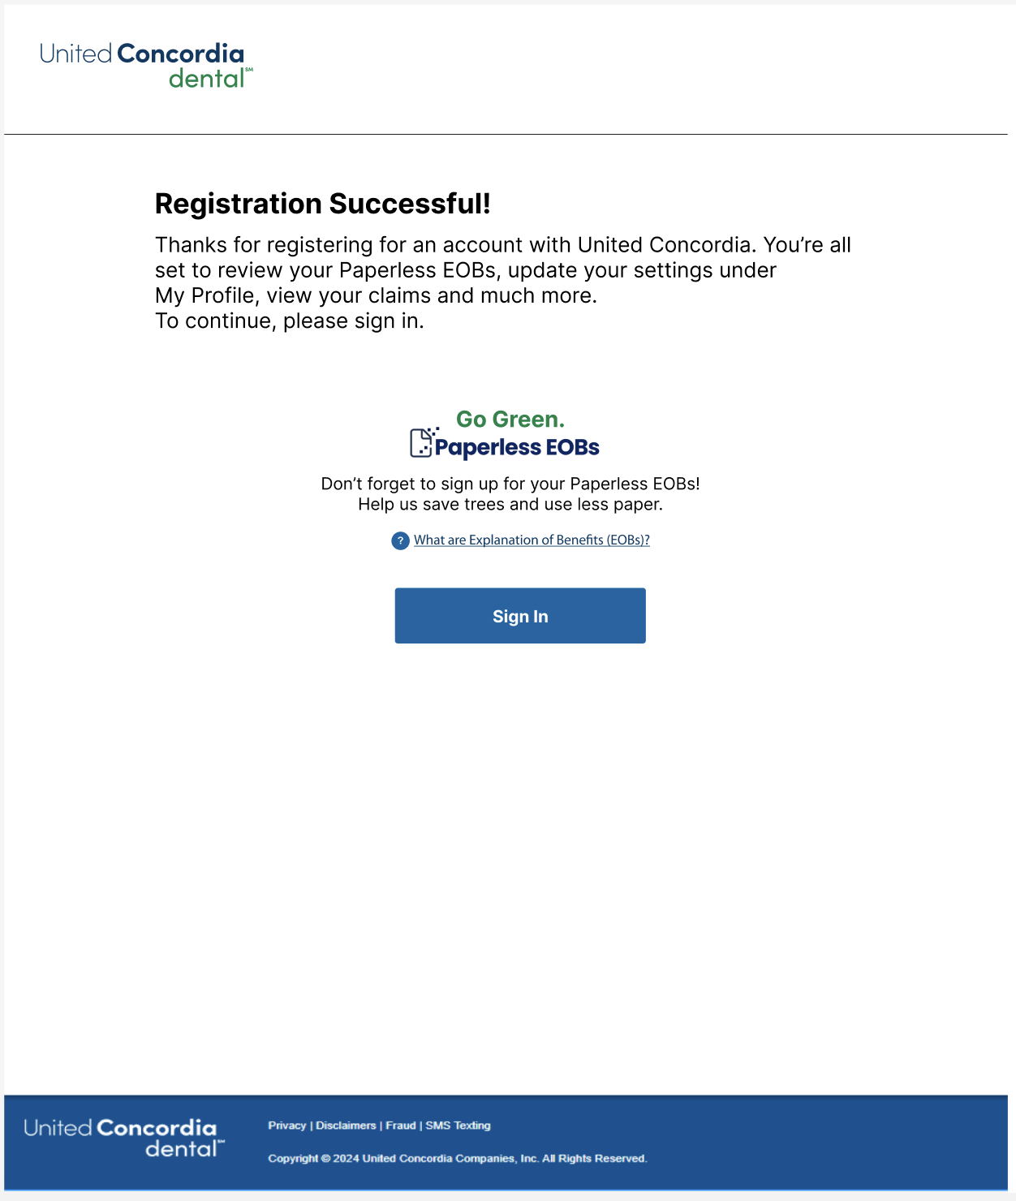
Simple Style - Registration Success Enhancement - Sign in screen, User opts out
1
Consider displaying a registration success screen, letting the user know that their Registration was successful.
Consider displaying alternate messaging for users who did not opt in on the Registration screen reminding users to “not forget” to enroll in Paperless and consider sharing information through “Go Green” messaging to share why they should go Paperless: saving trees, Help us reduce waste, less paper, etc.
Provide a link for them to learn more about EOBs.
Provide a link for the User to sign in to their account.
2
3
4
Notes:
Add
Add information about how to update PDO (Primary Dentist Office) or family information to help center and in MDB or linking MDB to Help Center
Help Center should be nurtured over time. Pruning what isn’t being used and adding new topics that align with VoC data
Help Center
We recommend maintaining (adding and removing) the Help Center and use consistent keywords in titles
Consider advocating for LucidWorks to improve the search functionality
ID
We recommend further research on the topic

Slide 22
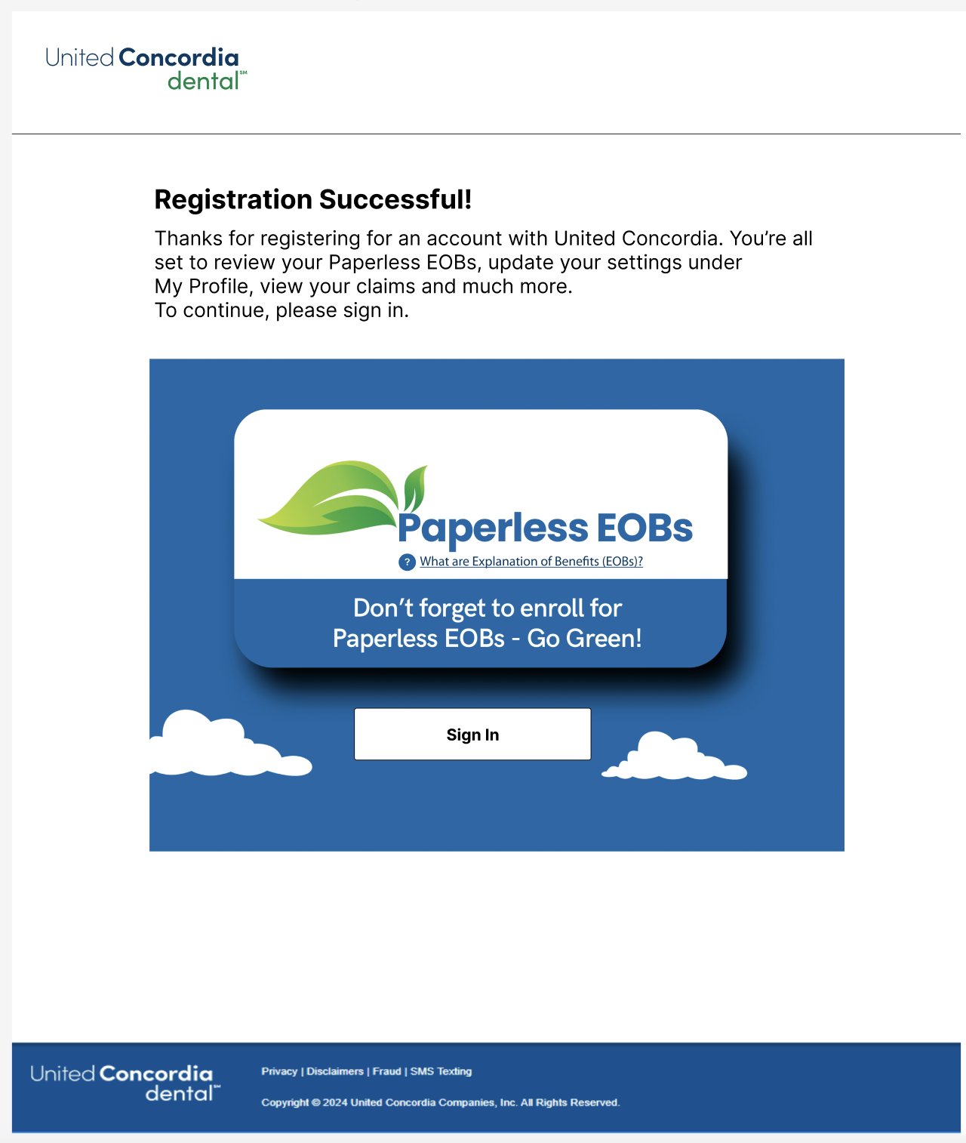
Graphic Style - Registration Success Enhancement -
Sign in screen,
User opts out
1
Consider displaying a registration success screen to replace the Relay screen, letting the user know that their Registration was successful.
Consider displaying alternate messaging for users who did not opt in on the Registration screen reminding users to “not forget” to enroll in Paperless and consider sharing information through “Go Green” messaging to share why they should go Paperless: saving trees, less waste, less paper, etc.
Provide a link for them to learn more about EOBs.
Provide a link for the User to sign in to their account.
2
3
4
Notes:
Add
Add information about how to update PDO (Primary Dentist Office) or family information to help center and in MDB or linking MDB to Help Center
Help Center should be nurtured over time. Pruning what isn’t being used and adding new topics that align with VoC data
Help Center
We recommend maintaining (adding and removing) the Help Center and use consistent keywords in titles
Consider advocating for LucidWorks to improve the search functionality
ID
We recommend further research on the topic

Slide 23
Enrollment Summary –
Paperless EOB
Banners
1
Implement a Paperless EOB alert banner. The alert Banner tested well.
Consider adding a second Banner at the bottom of the Enrollment Summary screen that is informational.
Consider adding a link to enroll in Paperless EOBs on the banner for those users who opted out on the Registration screen.
Consider adding a link to explain what Paperless EOBs are.
2
3
4

Slide 24
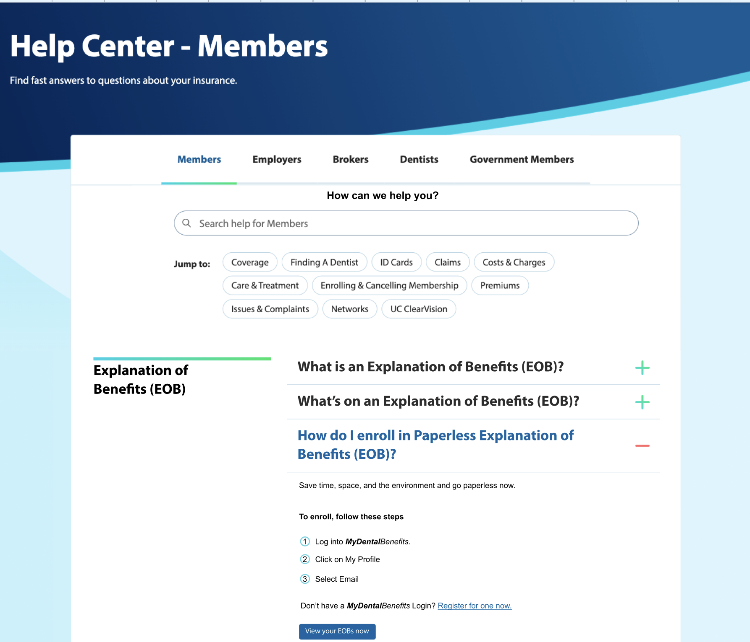
Help Center
1
2
3
Consider adding information about What is an EOB
Include what is on an EOB
Educate them on “how do I enroll in Paperless EOBs”
2. Add a call to action to view their EOBs now.
1
2
Notes:
Add
Add information about how to update PDO (Primary Dentist Office) or family information to help center and in MDB or linking MDB to Help Center
Help Center should be nurtured over time. Pruning what isn’t being used and adding new topics that align with VoC data
Help Center
We recommend maintaining (adding and removing) the Help Center and use consistent keywords in titles
Consider advocating for LucidWorks to improve the search functionality
ID
We recommend further research on the topic

Slide 25
Q&A

Slide 26
Thank You!

